Slide 1
emg2qwerty: A Large Dataset with Baselines for Touch Typing using Surface Electromyography
Viswanath Sivakumar, Jeffrey Seely, Alan Du, Sean R Bittner, Adam Berenzweig, Anuoluwapo Bolarinwa, Alexandre Gramfort, Michael I Mandel Reality Labs, Meta
NeurIPS 2024

Slide 2
Pioneering Human-Computer Interface for AR/VR Paradigm
Notes:
Carson Sloan made this slide using purchased stock images on Jun 30, 2020.

Slide 3
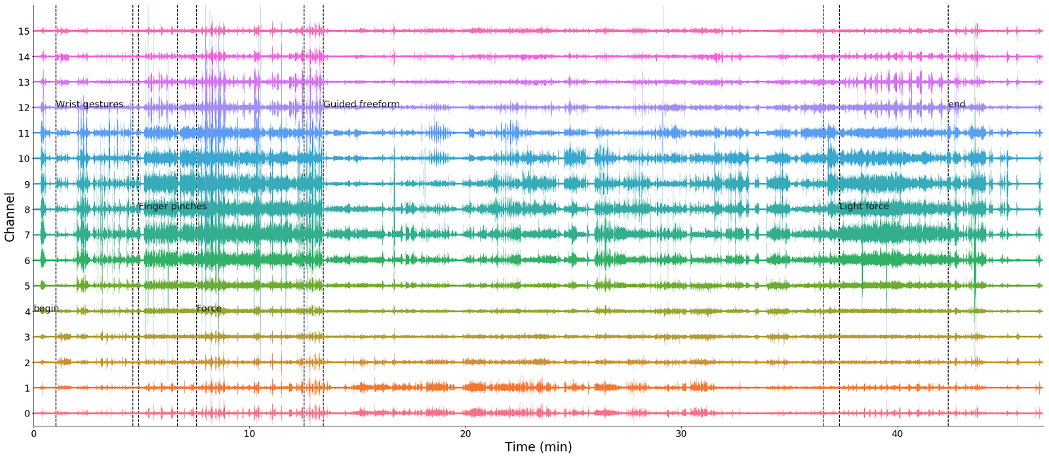
Pioneering Human-Computer Interface for AR/VR Paradigm
Notes:
Carson Sloan made this slide using purchased stock images on Jun 30, 2020.

Slide 4
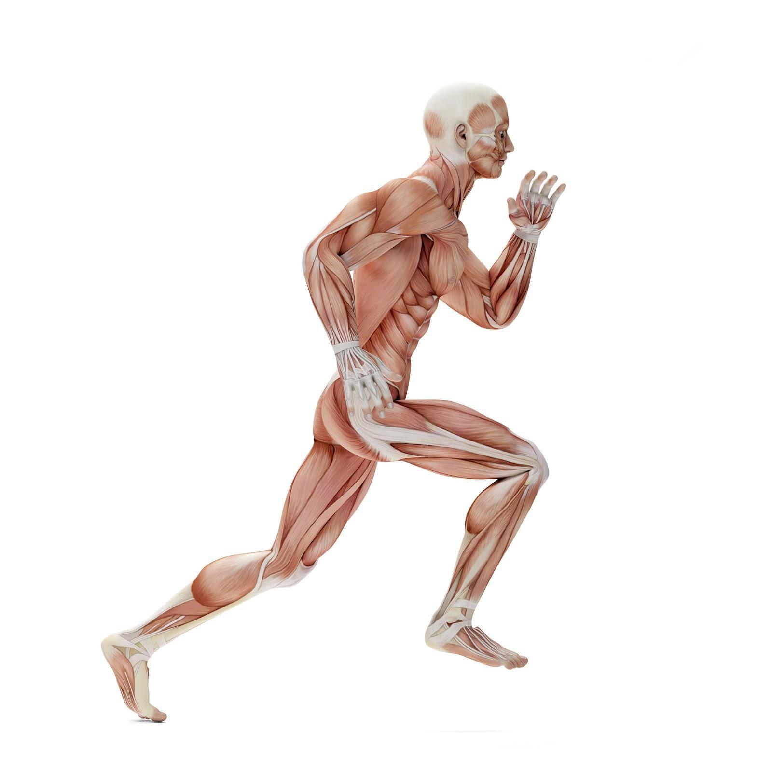
Pioneering Human-Computer Interface for AR/VR Paradigm
Notes:
Carson Sloan made this slide using purchased stock images on Jun 30, 2020.

Slide 5
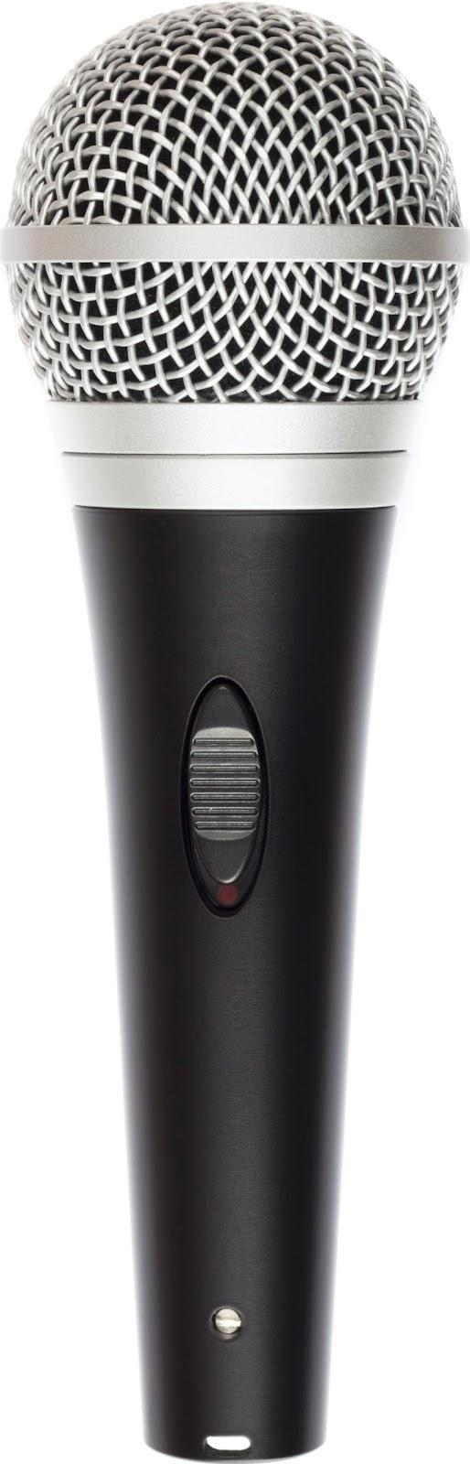
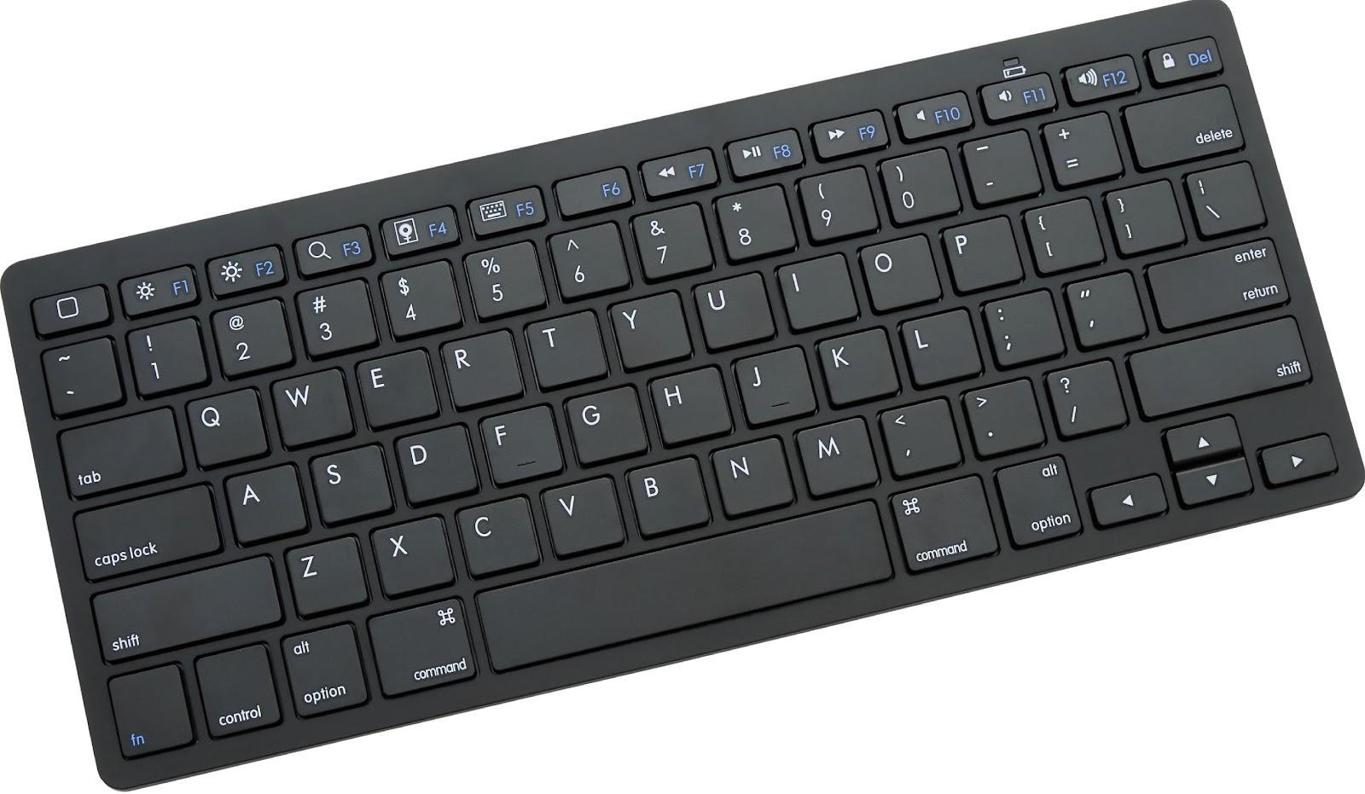
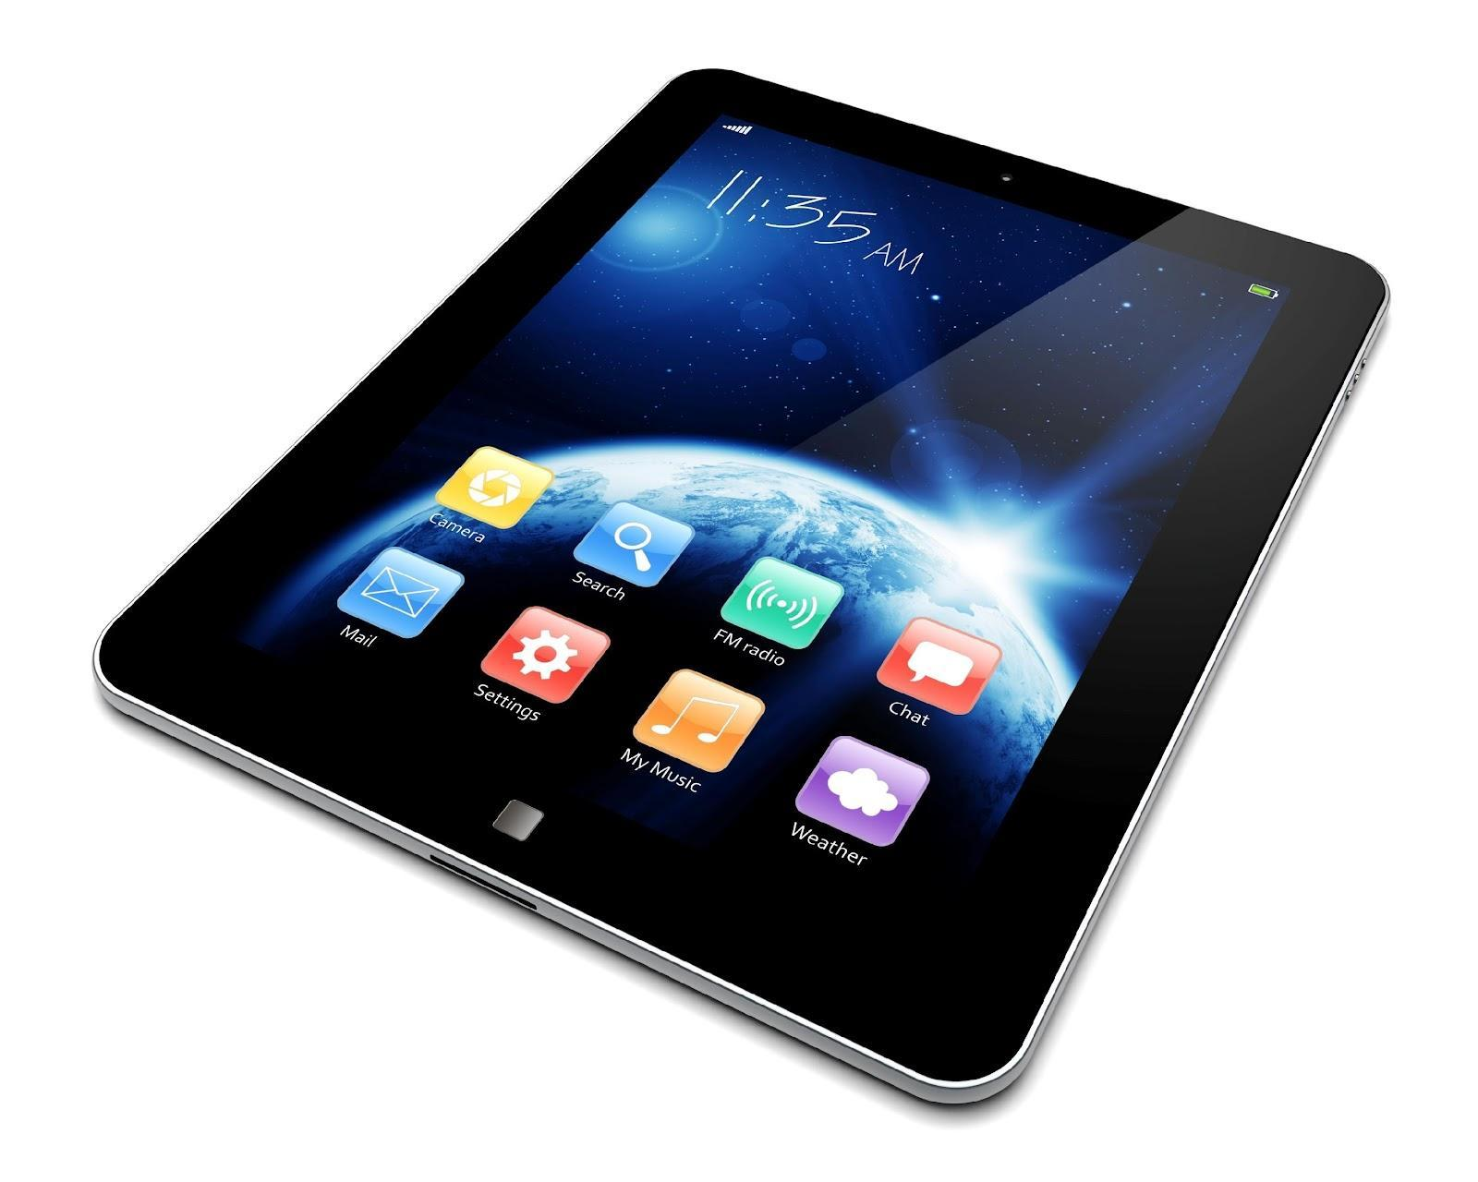
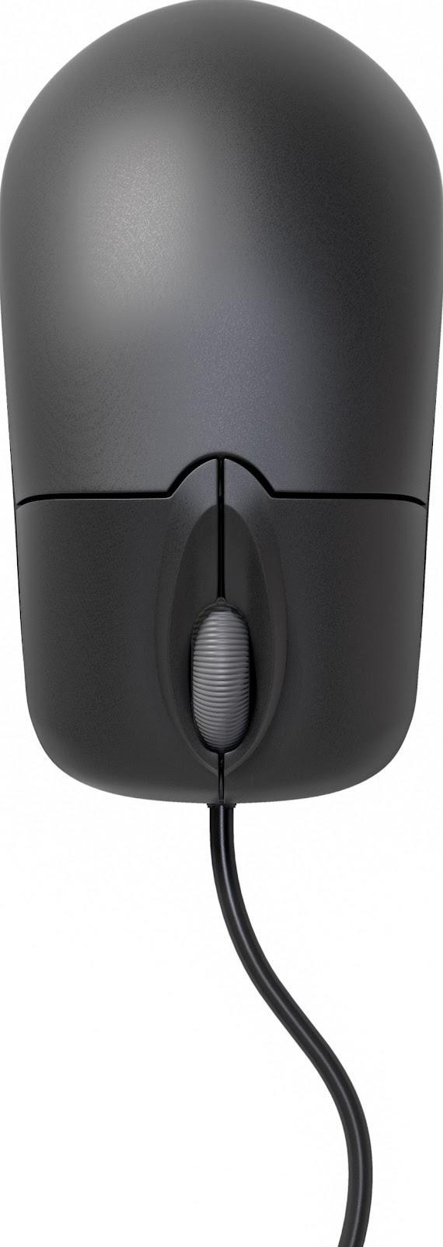
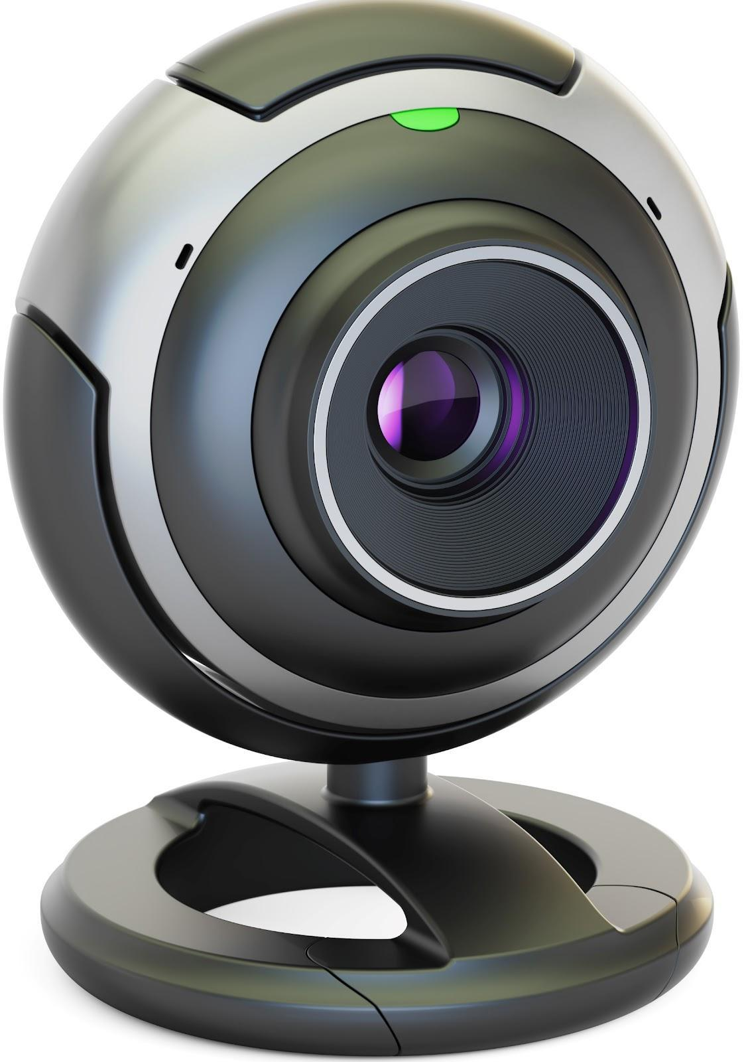
Pioneering Human-Computer Interface for AR/VR Paradigm
Notes:
Carson Sloan made this slide using purchased stock images on Jun 30, 2020.

Slide 6
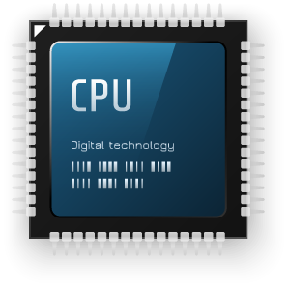
Pioneering Human-Computer Interface for AR/VR Paradigm
Notes:
Carson Sloan made this slide using purchased stock images on Jun 30, 2020.

Slide 7
Pioneering Human-Computer Interface for AR/VR Paradigm
Notes:
Carson Sloan made this slide using purchased stock images on Jun 30, 2020.

Slide 8
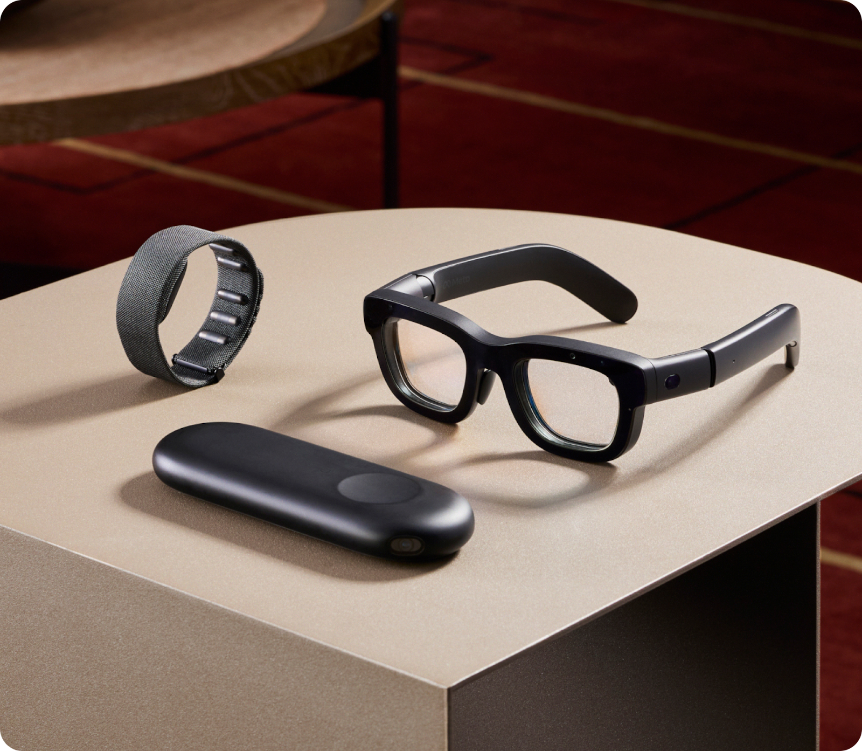
Pioneering Human-Computer Interface for AR/VR Paradigm
Meta Orion Prototype
Notes:
Carson Sloan made this slide using purchased stock images on Jun 30, 2020.

Slide 9
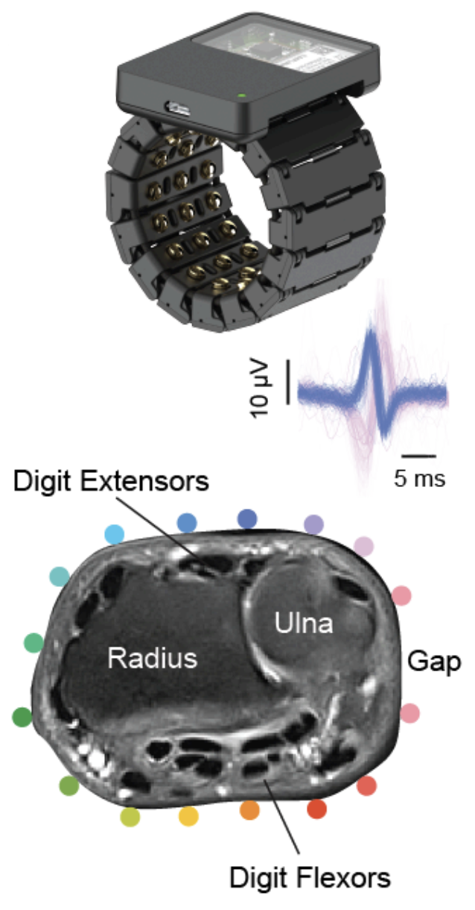
Background on surface electromyography (sEMG)
sEMG captures electrical signals from muscles via sensors on the skin, offering a non-invasive way to measure muscle activity.
Non-invasive electrode placement around the wrist circumference.
Notes:
Image license CC-SA-4.0: https://commons.wikimedia.org/wiki/File:Motor_unit.png

Slide 10
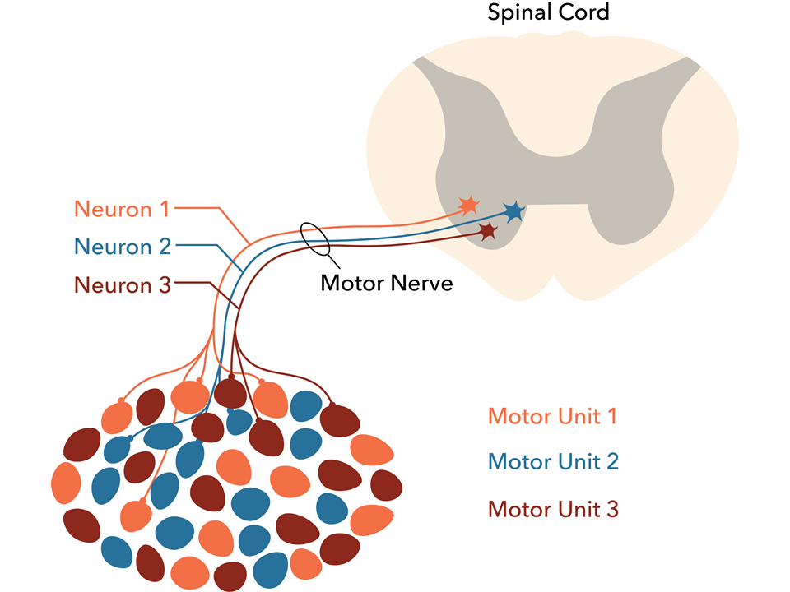
Background on surface electromyography (sEMG)
sEMG captures electrical signals from muscles via sensors on the skin, offering a non-invasive way to measure muscle activity.
It detects the electrical potentials generated by individual motor neurons enabling insights into neuromuscular activity with high temporal precision.
Non-invasive electrode placement around the wrist circumference.
The Motor Unit. Image credit: Daniel Walsh and Alan Sved. https://commons.wikimedia.org/wiki/File:Motor_unit.png
Notes:
Image license CC-SA-4.0: https://commons.wikimedia.org/wiki/File:Motor_unit.png

Slide 11
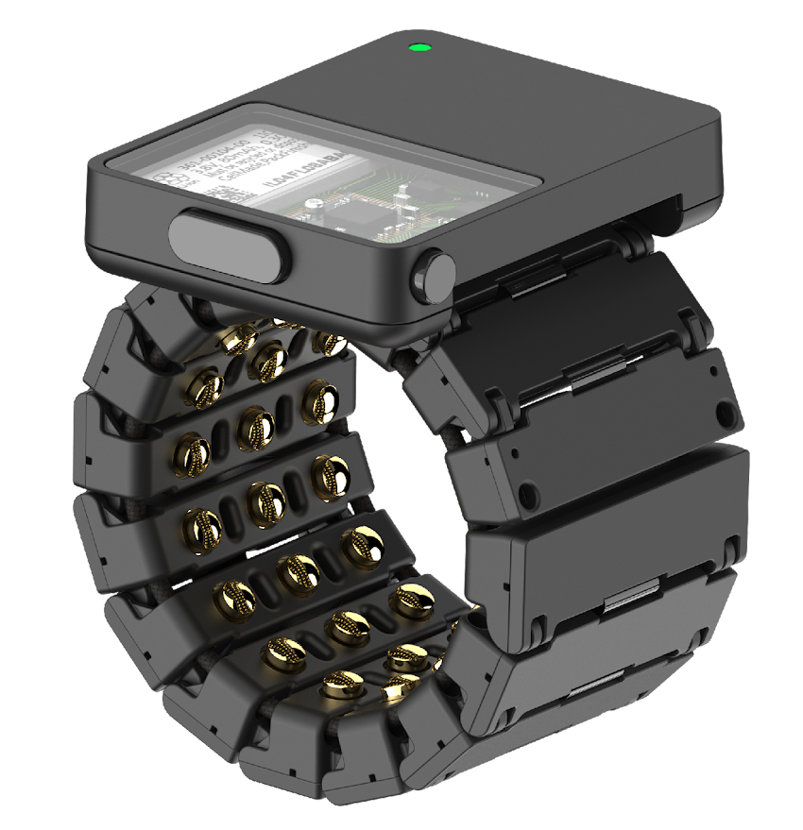
Background on surface electromyography (sEMG)
sEMG captures electrical signals from muscles via sensors on the skin, offering a non-invasive way to measure muscle activity.
It detects the electrical potentials generated by individual motor neurons enabling insights into neuromuscular activity with high temporal precision.
Data is collected using a research-grade wristband with 16 gold-plated dry electrodes, providing high-quality sEMG signals at a sampling rate of 2 kHz.
Non-invasive electrode placement around the wrist circumference.
The Motor Unit. Image credit: Daniel Walsh and Alan Sved. https://commons.wikimedia.org/wiki/File:Motor_unit.png
The sEMG research device as described in CTRL-labs at Reality Labs et al., 2024 used for data collection.
Notes:
Image license CC-SA-4.0: https://commons.wikimedia.org/wiki/File:Motor_unit.png

Slide 12
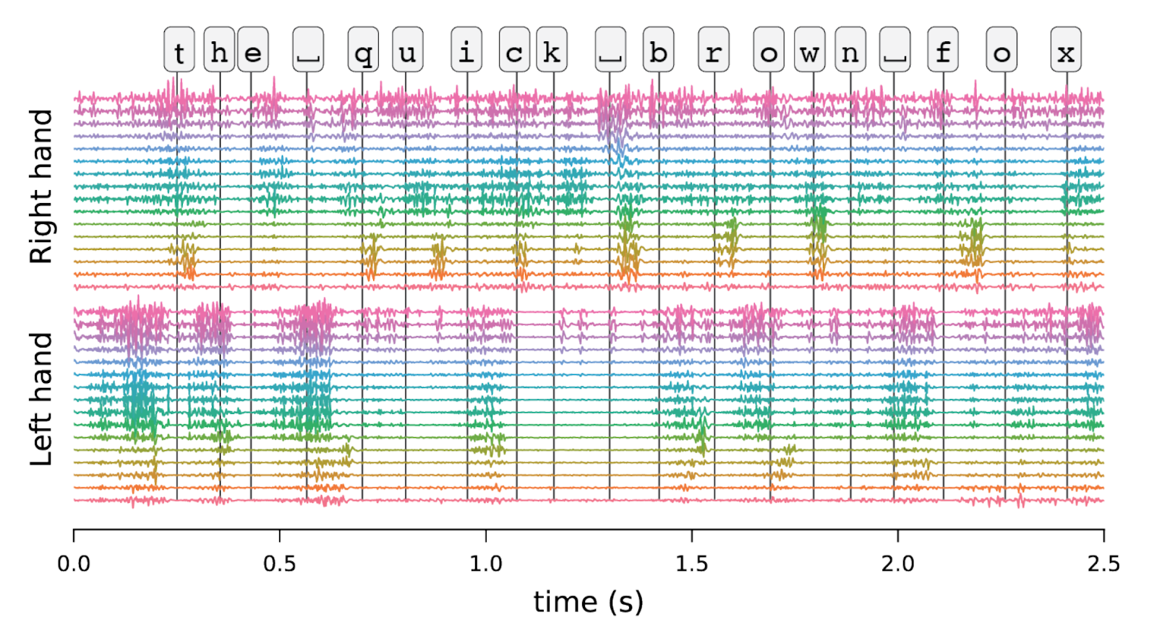
A dataset of sEMG collected while touch typing
16 electrode channels
16 electrode channels
sEMG recording for the prompt “the quick brown fox”. Vertical lines indicate keystroke onset. Signal is sampled at 2 kHz and is high-pass filtered.

Slide 13
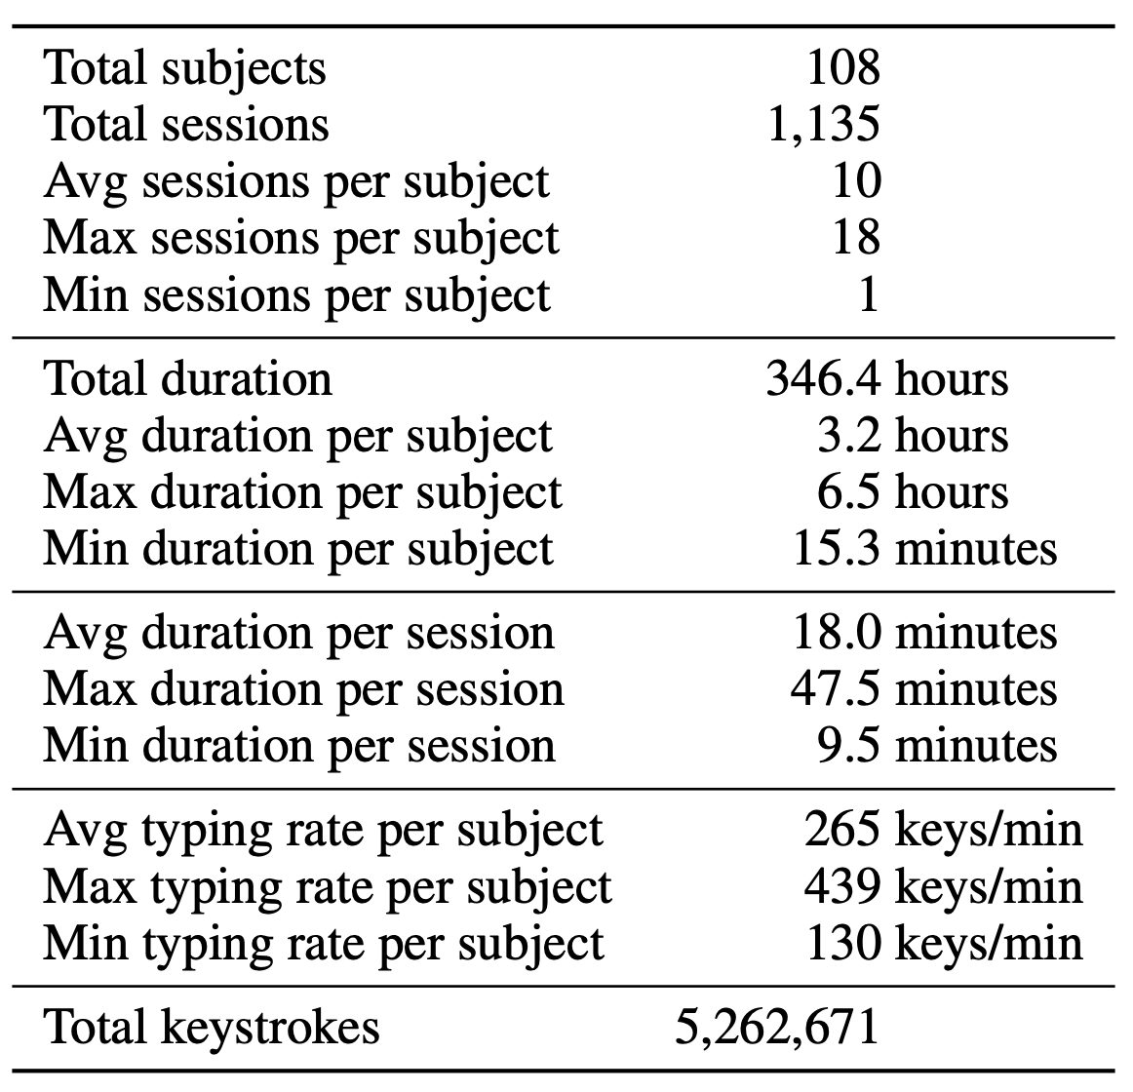
A dataset of sEMG collected while touch typing
16 electrode channels
16 electrode channels
sEMG recording for the prompt “the quick brown fox”. Vertical lines indicate keystroke onset. Signal is sampled at 2 kHz and is high-pass filtered.
emg2qwerty dataset statistics

Slide 14
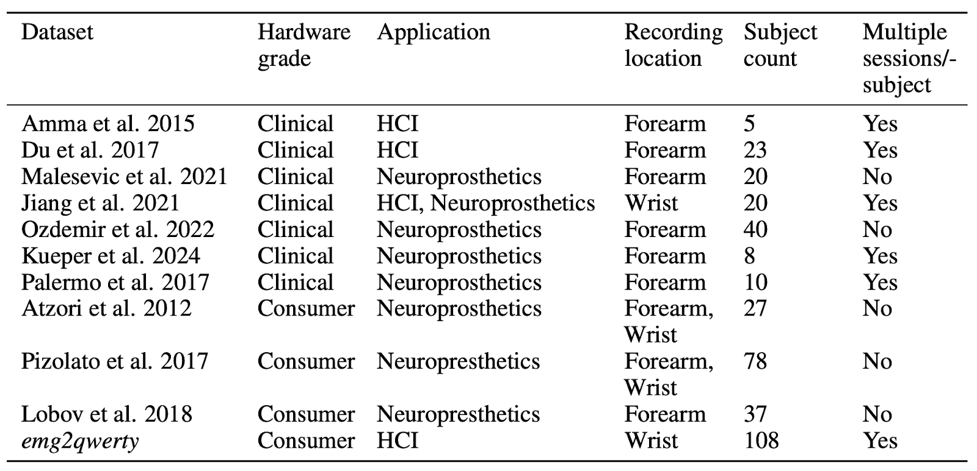
Uniqueness of emg2qwerty
Unique in terms of
Scale: Order of magnitude larger with 108 subjects and an average of 10 sessions per subject.
Comparison with prior EMG datasets

Slide 15
Uniqueness of emg2qwerty
Unique in terms of
Scale: Order of magnitude larger with 108 subjects and an average of 10 sessions per subject.
Hardware Properties: Consumer-grade practicality with clinical-grade signal quality.
Comparison with prior EMG datasets

Slide 16
Uniqueness of emg2qwerty
Unique in terms of
Scale: Order of magnitude larger with 108 subjects and an average of 10 sessions per subject.
Hardware Properties: Consumer-grade practicality with clinical-grade signal quality.
Task Activity: Naturalistic behavior of typing, rapidly time-varying task.
Comparison with prior EMG datasets

Slide 17
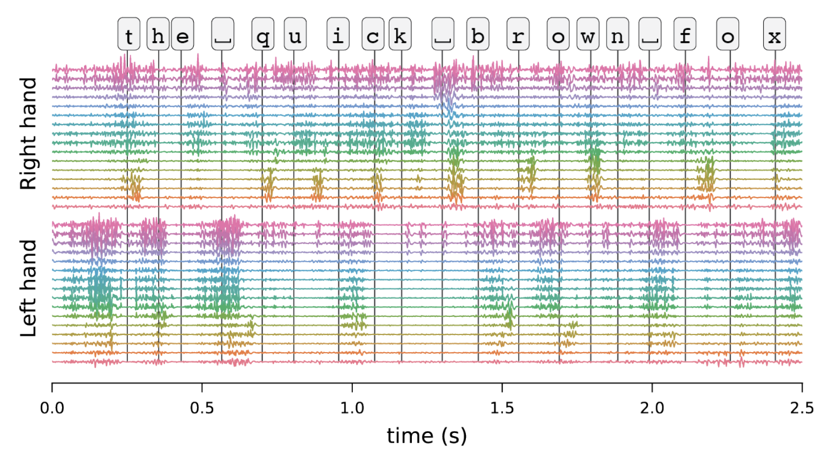
Baseline via Automatic Speech Recognition (ASR) Methodologies

Slide 18
Baseline via Automatic Speech Recognition (ASR) Methodologies
Spectral Features

Slide 19
Baseline via Automatic Speech Recognition (ASR) Methodologies
SpecAugment
Spectral Features

Slide 20
Baseline via Automatic Speech Recognition (ASR) Methodologies
Time-Depth Separable Convolutions
SpecAugment
Spectral Features

Slide 21
Baseline via Automatic Speech Recognition (ASR) Methodologies
CTC Loss
Time-Depth Separable Convolutions
SpecAugment
Spectral Features

Slide 22
Baseline via Automatic Speech Recognition (ASR) Methodologies
CTC Loss
Language Model + Backspace-Aware Beam-Search Decoder
Time-Depth Separable Convolutions
SpecAugment
Spectral Features

Slide 23
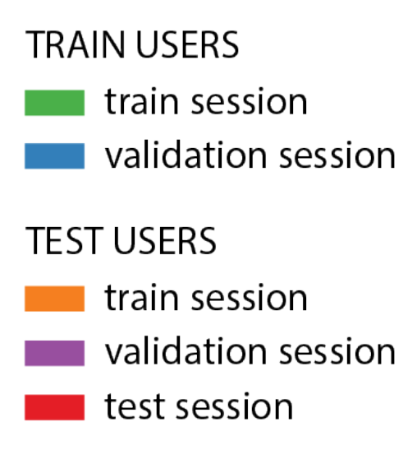
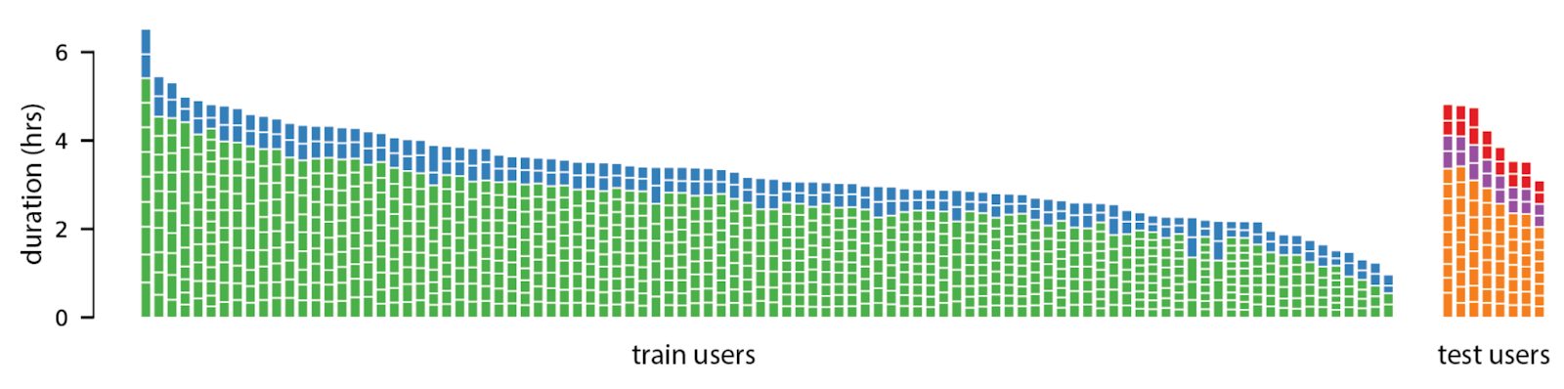
Benchmarks
Model Benchmark | Test Character Error Rate (CER)
 | No Language Model | 6-gram Character-Level Language Model
Generic (no personalization) | 55.38 ± 4.10 | 51.78 ± 4.61
Personalized (random-init) | 15.38 ± 5.88 | 9.55 ± 5.16
Personalized (finetuned) | 11.28 ± 4.45 | 6.95 ± 3.61
Character Error Rate (CER): Lower is better. Models tend to become usable at a CER of 10% or less.
Dataset Splits

Slide 24
Benchmarks
Model Benchmark | Test Character Error Rate (CER)
 | No Language Model | 6-gram Character-Level Language Model
Generic (no personalization) | 55.38 ± 4.10 | 51.78 ± 4.61
Personalized (random-init) | 15.38 ± 5.88 | 9.55 ± 5.16
Personalized (finetuned) | 11.28 ± 4.45 | 6.95 ± 3.61
Character Error Rate (CER): Lower is better. Models tend to become usable at a CER of 10% or less.
Dataset Splits
Personalized models finetuned from a generic model perform best.
sEMG representations can generalize across users despite variations in sensor placement, anatomy, physiology, and behavior.
Generic model at current scale remains unusable, although CTRL-labs at Reality Labs et al., 2024 demonstrates out-of-the-box generalization with an order of magnitude more training users on different tasks.
Motivates research into data-efficient strategies to improve generalization.

Slide 25
Benchmarks
Model Benchmark | Test Character Error Rate (CER)
 | No Language Model | 6-gram Character-Level Language Model
Generic (no personalization) | 55.38 ± 4.10 | 51.78 ± 4.61
Personalized (random-init) | 15.38 ± 5.88 | 9.55 ± 5.16
Personalized (finetuned) | 11.28 ± 4.45 | 6.95 ± 3.61
Character Error Rate (CER): Lower is better. Models tend to become usable at a CER of 10% or less.
Dataset Splits
Personalized models finetuned from a generic model perform best.
sEMG representations can generalize across users despite variations in sensor placement, anatomy, physiology, and behavior.
Generic model at current scale remains unusable, although CTRL-labs at Reality Labs et al., 2024 demonstrates out-of-the-box generalization with an order of magnitude more training users on different tasks.
Motivates research into data-efficient strategies to improve generalization.

Slide 26
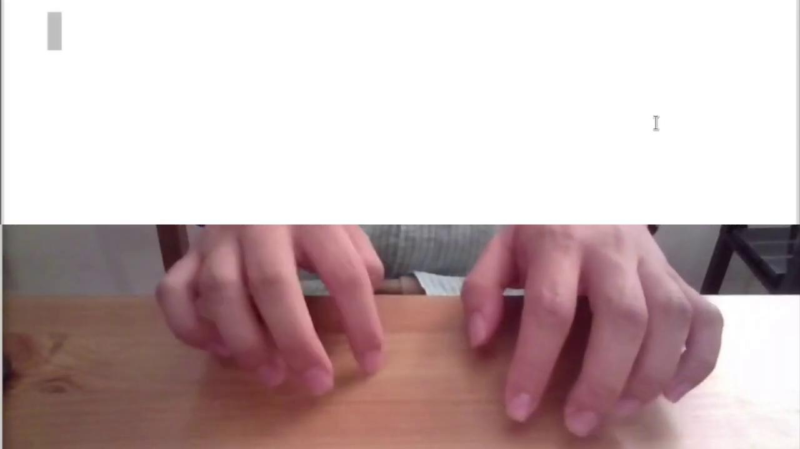

Slide 27
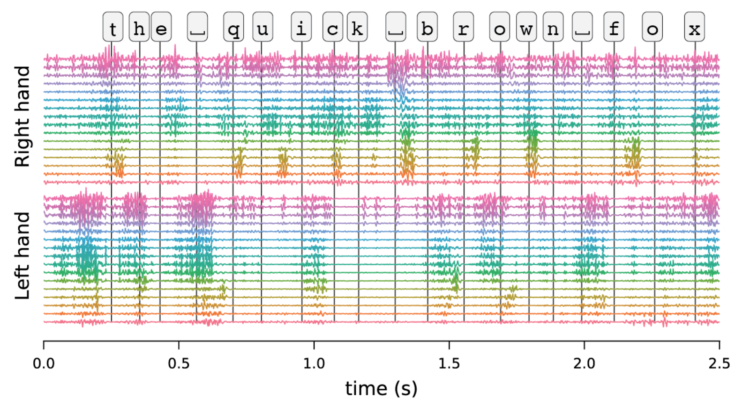
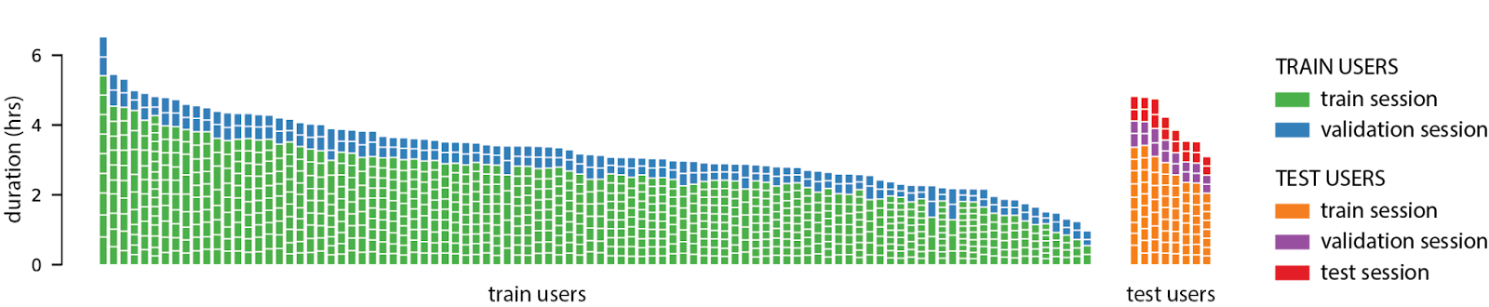
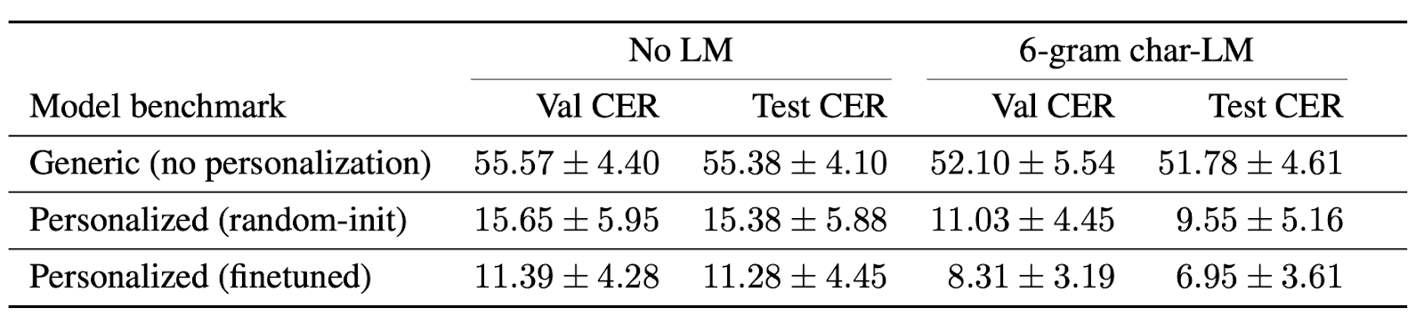
Summary
Wrist-based surface electromyography (sEMG) enables building practical and scalable neuromotor interfaces.
We release a large open sEMG dataset focused on the task of keyboard typing with accurate ground-truth.
We establish benchmarks focused on generalization across unseen population and data-efficiency of personalization.
We demonstrate competitive baselines using off-the-shelf ASR methodologies against those benchmarks.
Dataset and Code available now! github.com/facebookresearch/emg2qwerty
Questions? viswanath@meta.com

